Slide 1
Quantum
Year 12

Slide 2
Page Set up
Set up the first page of every lesson like this and rule a column line for every page after the first page that is used during the lesson.
Focus: State the Chapter Number, Title and the page numbers (3 lines).
Keywords: During the lesson write out your own keywords used during the lesson. (8 lines)
Context: During the lesson write in this section what this topic relates to in the ‘real’ world. How is this content used to better society? (5 lines)

Slide 3
Matter
Chapter 10.1 Pages 284 - 290

Slide 4
Quarks
The six Quarks are
up, down,
charmed, strange,
top, bottom.
These are referred to as “flavours”.
“Colour”, “Spin” and “Baryon number” is used to determine different particles of similar mass and charge.

Slide 5
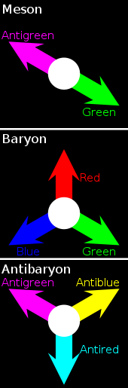
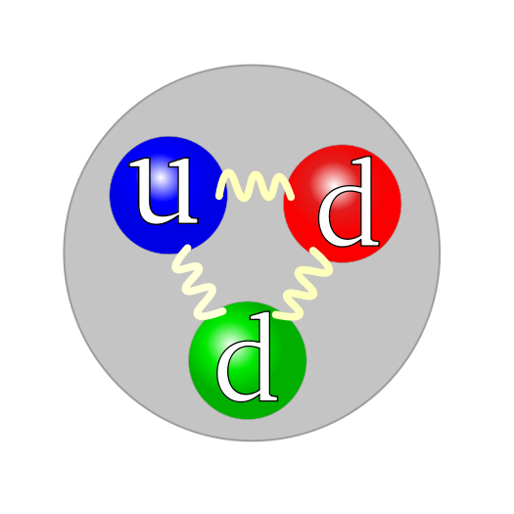
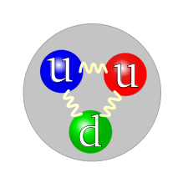
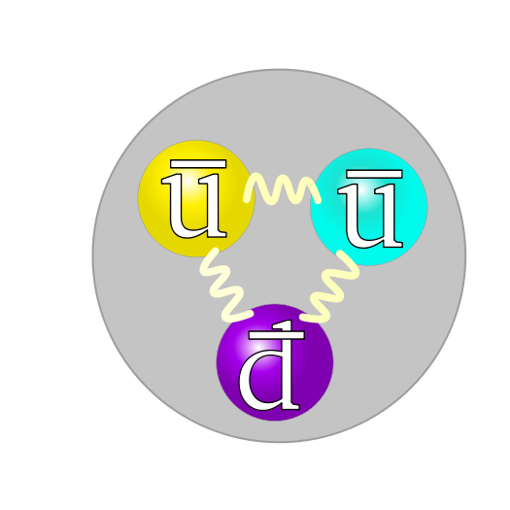
Quarks Colour
Colour → red, blue, green.
Anti-colour → cyan, magenta, yellow.
The quark forces are attractive only in "colorless" combinations of three quarks (Baryons) and quark-antiquark pairs (Mesons) and possibly larger combinations such as the pentaquark.
Neutrons
Protons
Anti-protons

Slide 6
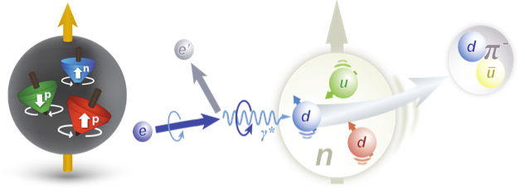
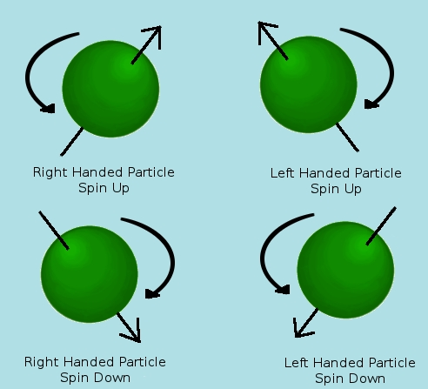
Quarks Spin
Spin → ±½.
Positive magnetic moments for quarks, and negative magnetic moments for antiquarks.
Refers to the rotation of the particle around its axis, but is more
relevant when
comparing larger
particles made
from quarks.

Slide 7
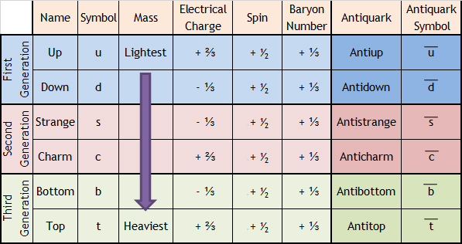
Quarks

Slide 8
Quarks
Conservation of matter means that the sum of the individual quarks electrical charge, spin and colour will total to the electrical charge, spin and colour of the resultant particle.
Example 10.1a: What quarks make up a proton and what is a possible spin combination for the proton given that a proton has a Baryon number of 1 and a proton uses the lightest possible quark combination?
Example 10.1b: What quarks make up a neutron and what is a possible spin combination for the neutron given that a neutron has a Baryon number of 1 and a neutron uses the lightest possible quark combination?

Slide 9
Leptons
Can be positive, negative or neutral in charge.
E.g. electrons (-1 C),
positrons (+1 C),
electron neutrino (0 C).
Leptons mostly interact by exchanging W and Z bosons.
Leptons will
Attract/Repulse
Annihilate/ Produce

Slide 10
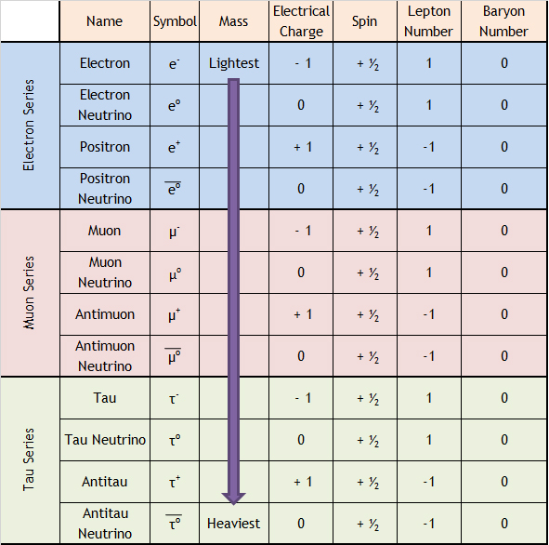
Leptons

Slide 11
Fermions
Fermions (matter)
Leptons
Quarks
Muons
Electrons
Tau
Onia
Hadrons
Muonium
Preons are hypothetically considered the sub-components of Quarks and Leptons
Mesons
Baryons
Kaon
Pion
Eta
Omega
Protons
Neutrons

Slide 12
Baryons
Addition of three quarks
Many types including;
Protons, Antiprotons
Neutrons, Antineutrons
Lambda series (λº, λº)
Sigma series (Σ⁺, Σº, Σ⁻)
Xi series (Ξ, and many more)
Omega series (Ω, and many more)
Delta series (Δ, and many more)
And many more not yet observed.

Slide 13
Mesons
Addition of one quark and one antiquark
Many types including;
Pion series (Π)
Kaon series (κ)
Upsilon series (Υ)
Rho series (ρ)
Psi series (ψ)
Eta series (η)
Phi series (ϕ)
D meson series (D)
B meson series (B)
And many more not yet observed.

Slide 14
Antimatter
There are anti-leptons and anti-quarks (where antimatter/antiparticles are formed from)
They are equal to matter in magnitude (mass, size, etc), but opposite in charge and with different magnetic moments.
Antibaryons, for example, are made of three antiquarks, just as baryons are made of three quarks

Slide 15
Baryons and Mesons
Example 10.1c: Compare Baryons and Mesons (2 similarities and 2 differences).
Example 10.1d: A pion-plus is the result of an up quark binding with an anti-down quark.
What is the charge of the Pion-plus
What is the Baryon number of the Pion-plus
Is a Pion-plus a Baryon or Meson? Explain.
Example 10.1e: What is the main difference between a Hadron and a Baryon, as well as a Hadron and a meson?

Slide 16
Fermions
Fermions (matter)
Leptons
Quarks
Muons
Electrons
Tau
Onia
Hadrons
Muonium
Leptons are seen to only
annihilate/produce
attract/repulse
No evidence yet that they decay/bind like Quarks do.
Mesons
Baryons
Kaon
Pion
Eta
Omega
Protons
Neutrons

Slide 17
Fermions
Fermions (matter)
Leptons
Quarks
Muons
Electrons
Tau
Onia
Hadrons
Muonium
Quarks are seen to produce many different particles, due to the Quarks ability to
annihilate/produce
attract/repulse
decay/bind
Mesons
Baryons
Kaon
Pion
Eta
Omega
Protons
Neutrons

Slide 18
Homework, Context & Keywords
Context: How is this content used to better society?
Understanding the make up of principle particles helps us understand the behaviour, integration and interaction of these particles, that leads us to better understand general relativity, and its possible links to special relativity.

Slide 19
Homework, Context & Keywords
Key Words
Quarks
Up
Down
Charmed
Strange
Bottom
Top
Colour
Spin
Baryon Number
Antimatter
Leptons
Hadrons
Baryons
Mesons
Leptons

Slide 20
Homework, Context & Keywords
Homework
Complete all questions from Set 10.1 - due first lesson next week.
Read Chapter 9.1, page 256-265 and answer
Q1, Q2 & Q3 Set 9.1
by next lesson.

Slide 21
Page Set up
Set up the first page of every lesson like this and rule a column line for every page after the first page that is used during the lesson.
Focus: State the Chapter Number, Title and the page numbers (3 lines).
Keywords: During the lesson write out your own keywords used during the lesson. (8 lines)
Context: During the lesson write in this section what this topic relates to in the ‘real’ world. How is this content used to better society? (5 lines)

Slide 22
Quantum Principles
Chapter 9.1 Pages 256 - 265

Slide 23
Antimatter
They are equal to matter in magnitude (mass, size, etc), but opposite in charge and with different magnetic moments (spins).
Matter and antimatter cannot coexist in the presence of each other without “annihilation”.
When matter collides with matter, some mass is transformed into energy, due to momentum change.
When matter and antimatter, all mass is converted into energy. In the case of Mesons, these are types of Bosons that become involved in the binding of particles.

Slide 24
Antimatter
Example 9.1a: Name the antimatter partner to a neutrino?
Example 9.1b: The fundamental particles are;
Example 9.1c: The fundamental particles which make up the matter we can see are?
Example 9.1d: Name a Hadron particle.

Slide 25
Pauli’s exclusion principle
No two electrons in an atom could have all four quantum numbers identical. At least one must be different.
These four quantum numbers are the;
Principle quantum number (n)
Orbital quantum number (l)
Orbital magnetic quantum number (m_{l})
Spin quantum number (m_{s})

Slide 26
Pauli’s exclusion principle
Principle quantum number (n) is defined by the energy level of the electron.
Orbital quantum number (l) describes the shape of the energy level. From zero (circular) to one (more elliptical).
Orbital magnetic quantum number (m_{l}) is the orientation of the orbit with reference to the x, y, and z axes in space. This ranges from -1 to 0 to 1.
Spin quantum number (m_{s}) is to determine whether the electron spins clockwise or anticlockwise (also known as parallel and antiparallel). The values are +½ or –½.

Slide 27
Pauli’s exclusion principle
Example 9.1e: In what way did Pauli’s work support that of Bohr, when thinking back to Bohrs work on light.
Example 9.1f: What did Pauli’s exclusion theory lead to in regards to Bohr’s studies of chemicals and their properties?

Slide 28
Particle Accelerators
Particle accelerators are used to study quantum particles by accelerating “heavy” particles to speeds close to the speed of light. These include;
Cathode Ray Oscilloscope (CRO)
Synchrotrons

Slide 29
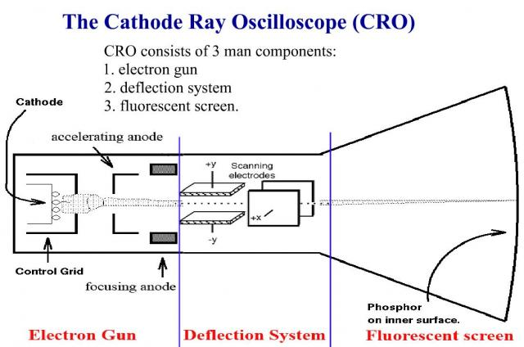
Cathode Ray Oscilloscope (CRO)
Cathode Ray Oscilloscope (CRO)
The Cathode Ray tube is a simple type of particle accelerator.
The electrons are released from a hot cathode negative terminal, in a vacuum.
The electron gun speeds up the electrons, while focussing them along a single path.
The deflecting plates direct the electrons towards the fluorescent screen, usually phosphorus coated.
Used as a linear accelerator with a maximum voltage of about 20 kV.

Slide 30
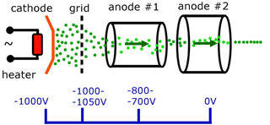
The Electron Gun
The particle accelerator uses the electron gun to accelerate the source of charged particles to be accelerated.
The electrons are expelled from a heated wire filament (cathodic). In a vacuum chamber they are accelerated from rest towards the positively charged (anodic) plate.

Slide 31
Voltage/Force Relationship
E = F = ΔV .
q d
E – electric field (N C-1)
q – electric charge (C)
F – force (N)
d – distance between plates (m)
ΔV – potential difference (V)

Slide 32
Voltage/Force Relationship
Example 9.1g: Two charged parallel plates are 12 cm apart with a potential difference of 240 V between them.
Calculate the electric field strength between them.
What force would be exerted on an electron located midway between the plates?
What force would be exerted on a proton located at the same point?

Slide 33
Voltage/Force Relationship
Example 9.1h: Two charged parallel plates are 5 mm apart and have an electric field intensity of 4.3 x 10⁴ V m⁻¹ between them.
Calculate the potential difference across the plates.
Determine the gain in kinetic energy if the electron moves from the negative plate to the positive plate?
If the electron was originally at rest, determine its final velocity.
Example 9.1i: Two charged parallel plates are 12 mm apart and have an electric field intensity of 3.8 x 10⁵ V m⁻¹ between them. If the 5 electrons was originally at rest, determine its final velocity.

Slide 34
Synchrotrons
Synchrotrons consist of the following major components;
The Electron Gun
The Linear Accelerator (Linac)
The Booster Ring
The Storage Ring
Insertion Devices
Beam lines and End Station

Slide 35
Synchrotrons
The Electron Gun - The electron gun is a vacuum system, focusing EM (laser light) onto a high voltage filament. Electrons escape from the electron gun as they boil off the heated filament. From here, they accelerate across a potential difference of above 100 keV and exit the electron gun at a velocity of approximately half the speed of light.
The Linear Accelerator (Linac) - The electron beam travels through an ultra-high vacuum within the linac, to prevent energy loss through interaction with air particles. As the electrons travel, focusing elements act on the beam to constrict it to a narrow beam in the centre of the vacuum tube.

Slide 36
Synchrotrons
The Booster Ring - Bending magnets provide a force at right angles to the motion of the electrons in order to bend them into a circular path. In this ring, the energy of the electrons is increased (boosted) from 100 to 3000 MeV. The energy boost is supplied by a radio-frequency (RF) chamber through which the electrons travel.
The Storage Ring - Around this ring are bending magnets each over 1.5 m long and with a field strength of over 1.0 T. These keep the electrons in the circular path.

Slide 37
Synchrotrons
Insertion Devices - The two main types of insertion devices are the wiggler and the undulator. These are inserted within straight sections of the storage ring, between existing dipole (bending) and corrector magnets. This provides a much brighter X-ray beams with high intensity.

Slide 38
Synchrotrons
Beam lines and End Station - A beamline is the path that synchrotron light travels from the storage ring, where it is produced, to its target experimental work. The point at which the beamline meets the storage ring is called the front end. Inside the optics room, synchrotron light is modified according to the needs of its experimental use. Sometimes scientists will wish to use only a specific range of wavelengths of synchrotron light for their experiments, rather than all of the light produced. A device called a monochromator, either a crystal or a grating, is used as a wavelength selector.

Slide 39
Homework, Context & Keywords
Context: How is this content used to better society?
Understanding the make up of principle particles helps us understand the behaviour, integration and interaction of these particles, that leads us to better understand general relativity, and its possible links to special relativity.

Slide 40
Homework, Context & Keywords
Key Words
Antimatter
Pauli’s Exclusion Principle
Particle Accelerator
Cathode Ray Oscilloscope
Electron Gun
Linear Accelerator (Linac)
Booster Ring
Storage Ring
Insertion Devices
Beam lines
End Station

Slide 41
Homework, Context & Keywords
Homework
Complete all questions from Set 9.1 - due first lesson next week.
Read Chapter 9.2, page 266-268 and answer
Q1, Q2 & Q3 Set 9.2
by next lesson.

Slide 42
Page Set up
Set up the first page of every lesson like this and rule a column line for every page after the first page that is used during the lesson.
Focus: State the Chapter Number, Title and the page numbers (3 lines).
Keywords: During the lesson write out your own keywords used during the lesson. (8 lines)
Context: During the lesson write in this section what this topic relates to in the ‘real’ world. How is this content used to better society? (5 lines)

Slide 43
Quantum Forces
Chapter 9.2 Pages 266 - 268

Slide 44
Fermions
Fermions (matter)
Leptons
Quarks
Muons
Electrons
Tau
Onia
Hadrons
Muonium
Mesons
Baryons
Kaon
Pion
Eta
Omega
Protons
Neutrons

Slide 45
Four Fundamental Forces
Strong Force (10³⁹ N)
e.g. Gluons (force carrying particles)
Electromagnetic Force (10³⁷ N)
e.g. Photons (force carrying particles)
Weak-nuclear Force (10³³ N)
e.g. Bosons W⁺, W⁻, Zº (force carrying particles)
Gravitational Force (10¹ N)
e.g. Gravitons (wave particle force)

Slide 46
Four Fundamental Forces
One of the four fundamental forces will be involved in any particle interaction.
For example; if 2 electrons are on a collision path they will repulse each other. That change in direction releases a photon. The photon is energy emitted due to the force created between the two electrons before the change of direction. A photon is apart of the Electromagnetic Force series.

Slide 47
Homework, Context & Keywords
Context: How is this content used to better society?
Understanding the make up of principle particles helps us understand the behaviour, integration and interaction of these particles, that leads us to better understand general relativity, and its possible links to special relativity.

Slide 48
Homework, Context & Keywords
Key Words
Electromagnetic Force
Strong-nuclear Force
Weak-nuclear Force
Gravitational Force
Photons
Gluons
Bosons W⁺, W⁻, Zº
Gravitons
Force carrying particles
Wave particle force

Slide 49
Homework, Context & Keywords
Homework
Complete all questions from Set 9.2 - due first lesson next week.
Read Chapter 10.2, page 291-297 and answer
Q1 & Q2 Set 10.2
by next lesson.

Slide 50
Page Set up
Set up the first page of every lesson like this and rule a column line for every page after the first page that is used during the lesson.
Focus: State the Chapter Number, Title and the page numbers (3 lines).
Keywords: During the lesson write out your own keywords used during the lesson. (8 lines)
Context: During the lesson write in this section what this topic relates to in the ‘real’ world. How is this content used to better society? (5 lines)

Slide 51
Fundamental Forces
Chapter 10.2 Pages 291 - 297

Slide 52
Four Fundamental Forces
Strong Force (10³⁹ N)
e.g. Gluons (force carrying particles)
Electromagnetic Force (10³⁷ N)
e.g. Photons (force carrying particles)
Weak-nuclear Force (10³³ N)
e.g. Bosons W⁺, W⁻, Zº (force carrying particles)
Gravitational Force (10¹ N)
e.g. Gravitons (wave particle force)

Slide 53
Strong Force
Also called the “strong nuclear force” or “nuclear strong force” in different texts.
“Strong force” is exclusively for quarks and particle made up of quarks.
“Strong nuclear force” is for nucleons in the nucleus.
But for particles made up of quarks, such as protons and neutrons, found in the nucleus, these labels, i.e “strong force” and “strong nuclear force” are interchangeable.

Slide 54
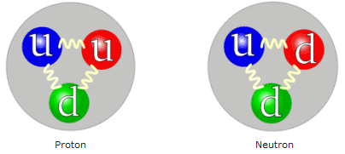
Strong Force
This is a force holding the protons with other protons and neutrons within the nucleus.
Even the quarks that make up the protons and neutrons are held together by gluons (a strong force).
Two events occur that keeps these nucleons bound
The meson interaction (a type of boson)
The nuclear force to electromagnetism force (aka electrostatic force) relationship.

Slide 55
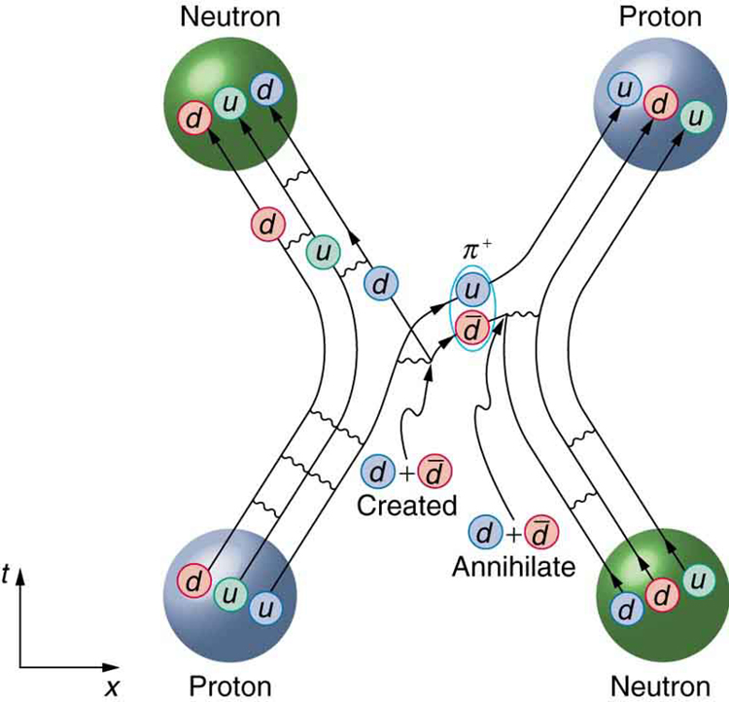
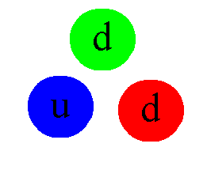
Strong Force: Mesons
A strong nuclear force relies on mesons being exchanged between nucleons (a meson is a quark and antiquark). The meson bounces between two nucleons and this is the strong force holding them together.

Slide 56
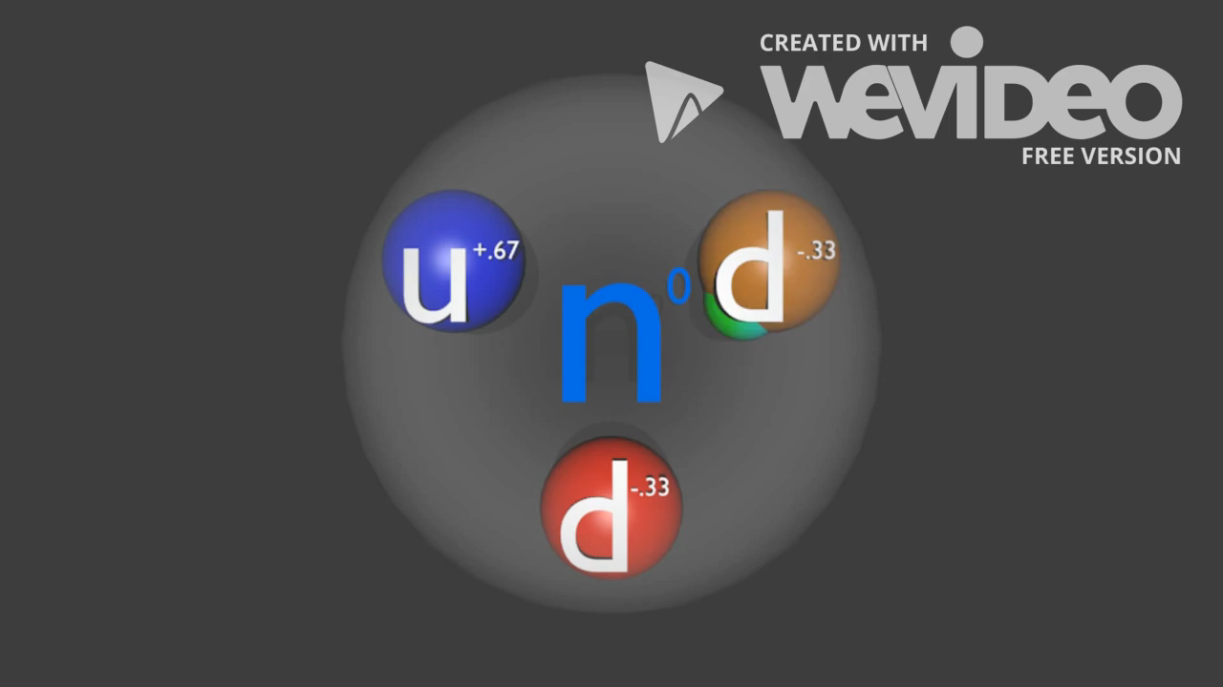
Strong Force: Mesons
The quarks of an individual nuclei are constantly interacting with each other through the gluons (strong forces).
Two nuclei also interact with use of mesons. Most commonly Pion Mesons.

Slide 57
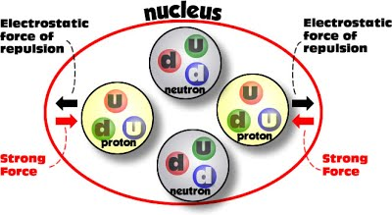

Strong Force: Electromagnetism
If two protons are far enough apart, then the force of electromagnetism is going to push them apart.
There is a “zone” where the strong force is greater than electromagnetism. This allows the two protons to stay close.
Within the zone
Strong Force > Electrostatic
Outside the zone
Electrostatic > Strong Force

Slide 58
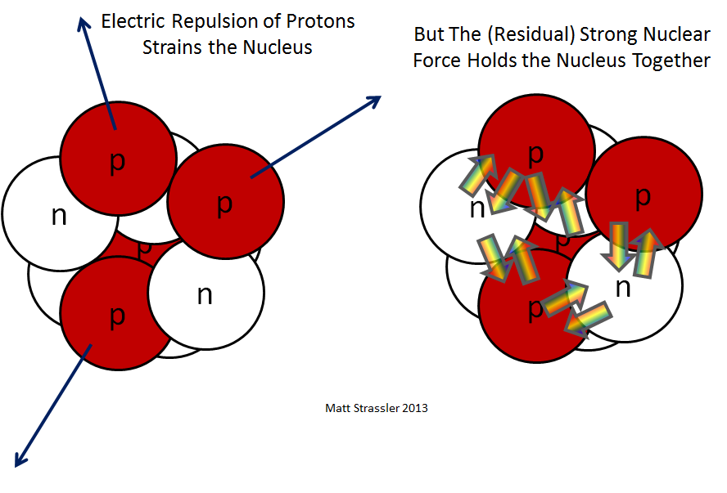
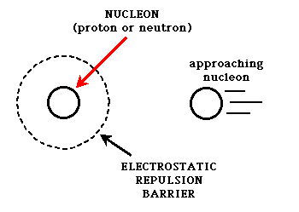
Strong Force: Electromagnetism
This strong force diameter of about 2 femtometers (or 2 x 10⁻¹⁵ m).
This is about 2 ½ times greater than a proton (a proton is about 0.877 x 10⁻¹⁵ m).

Slide 59
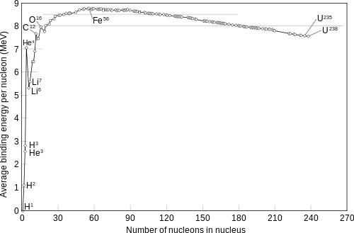
Strong Force: Electromagnetism
So hydrogen has one proton that will easily sit within this “barrier”. Helium has 4 nucleon, that again all sit inside the “barrier”. Also there is more nucleon and hence greater strong force between all of them, hence a greater binding energy. However with larger atoms, we
start to get nucleons outside the “barrier”.
The graph shows this occurs after Iron-56. Now the strong forces are not great enough to hold those nucleons in and we start getting radio decay.

Slide 60
Strong Force
Example 10.2a: Using your knowledge of the Gravitational Force and the Electrostatic Force, answer the following;
Calculate the gravitational force between two protons in a nucleus, given that they are a distance of 1.0 x 10⁻¹⁵ m from centre to centre of each other.
Find the electrostatic force between the two protons.
Calculate the ratio of the electrostatic force to the gravitational force between them.
Use this ratio to find the relative strength.
What does this tell us about the behaviour of more than one proton in the nucleus. Also what does it tell us about the atoms we know exist, in relation to the force holding them together.

Slide 61
Electromagnetic Force
Acts between electrically charged particles, both;
electrostatically when particles are at rest
electric and magnetic when particles are moving relative to one another.
Due to particles known as Photons.
Determines properties of chemical elements, including the chemical bonding.

Slide 62
Weak Nuclear Force
Also known as weak interaction force.
Involved in radioactive decay of nuclei.
Particles responsible for the weak force are the W and Z Boson particles.
Commonly involved in the Beta positive and Beta negative decays of nuclei.

Slide 63
Weak Nuclear Forces
Transmutation can take place where a neutron is changed to a proton or proton is changed to a neutron in the nucleus. This releases a Boson (weak force), which almost immediately changes to particles, such as neutrinos and electrons once ejected from the nucleus.

Slide 64
Gravitational Force
The weakest of the four fundamental forces.
Always attracts.
Particles involved in gravity are called gravitons.
Yet to be discovered.
F_{G} = G m₁ m₂ shows its relationship with matter.
r²

Slide 65
Homework, Context & Keywords
Context: How is this content used to better society?
Understanding the make up of principle particles helps us understand the behaviour, integration and interaction of these particles, that leads us to better understand general relativity, and its possible links to special relativity.

Slide 66
Homework, Context & Keywords
Key Words
Electromagnetic Force
Strong-nuclear Force
Weak-nuclear Force
Gravitational Force
Photons
Gluons
Bosons W⁺, W⁻, Zº
Gravitons
Force carrying particles
Wave particle force

Slide 67
Homework, Context & Keywords
Homework
Complete all questions from Set 10.2.2 - due first lesson next week.
Read Chapter 9.3, page 269-273 and answer
Q1 & Q2 Set 9.3
by next lesson.

Slide 68
Page Set up
Set up the first page of every lesson like this and rule a column line for every page after the first page that is used during the lesson.
Focus: State the Chapter Number, Title and the page numbers (3 lines).
Keywords: During the lesson write out your own keywords used during the lesson. (8 lines)
Context: During the lesson write in this section what this topic relates to in the ‘real’ world. How is this content used to better society? (5 lines)

Slide 69
Feynman Diagrams, Baryon Number and Lepton Number
Chapter 9.3 Pages 269 - 273

Slide 70
Conservation of the Baryon number and the Lepton number
Baryon number: whenever a reaction or decay occurs, the sum of the baryon numbers before the process must equal the sum of the baryon numbers after the process.
Lepton number: the sum of all lepton numbers involved in the reaction must be equal to the sum of all lepton numbers in the product.
Charge number: the sum of the charge must be conserved

Slide 71
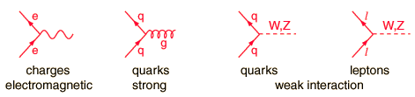
Feymans Diagrams
Graphical way to represent the exchange of forces.
Handout “Feyman Diagram”
SPACE
TIME

Slide 72
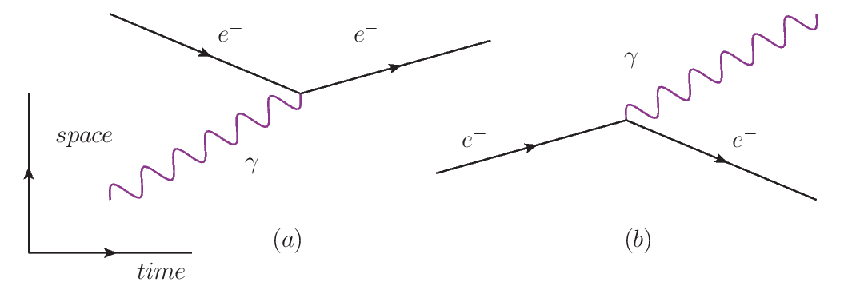
Feynman's Diagrams: Electron Changing Direction
Both of these diagrams show an electron changing direction.
Shows gamma being absorbed to change the electrons direction.
Shows an electron emitting a gamma ray when a forced change in direction occurs. Magnets can do this and this is what the “wobble” is in Synchrotrons to create the photon of energy.

Slide 73
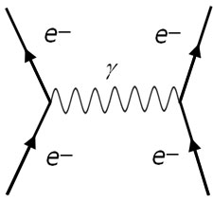
Feymans Diagrams: Two Electron Repulsion
SPACE
TIME

Slide 74
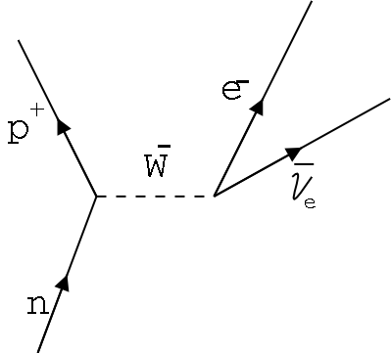
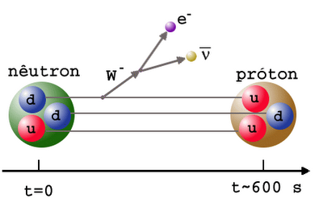
Feynman's Diagrams: Neutron Decay
Neutron Decay: n → p + e⁻ + v
The neutron (d, d, u) → proton (d, u, u), hence one of the downs needs to decay to an up.
This shows a “down” decays into an “up” releasing a W⁻ boson.
Hence the “neutron” becomes a “proton” and the W⁻ boson force becomes an “electron” and an “antineutrino”.

Slide 75
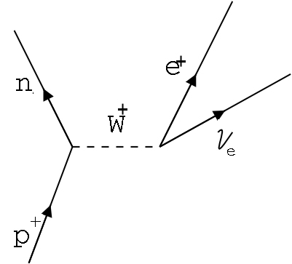
Feynman's Diagrams: Neutron Binding
Neutron Binding: p → n + e⁺ + v
The proton (d, u, u) → neutron (d, d, u), hence one of the ups needs to decay to a down.
This shows a “up” decays into an “down” releasing a W⁺ boson.
Hence the “proton” becomes a “neutron” and the W⁺ boson force becomes an “positron” and an “neutrino”.

Slide 76
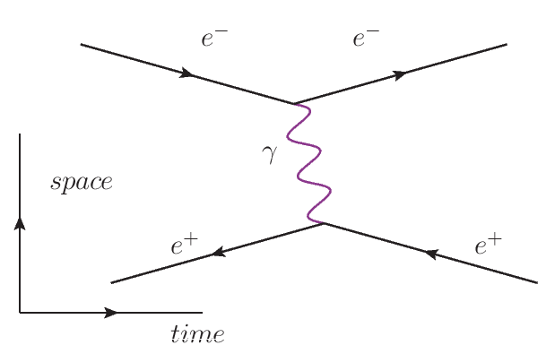
Feynman's Diagrams: Electron – Positron Attraction
Take note of the reverse arrows for the e⁺

Slide 77
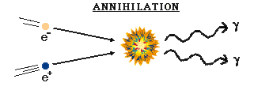
Feynman's Diagrams: Electron – Positron Annihilation
The electron and positron become a photon when they collide.
time
e⁻
e⁺

Slide 78
Feynman's Diagrams: Electron – Positron Production
e⁻
e⁺
The electron and positron are produced from a photon.
This cannot just spontaneously occur. Mostly there has to be a change in momentum, such as the photon interacting with a neutron or an atom. But only in a particular way that the neutron or atom do not change and get directly involved.

Slide 79
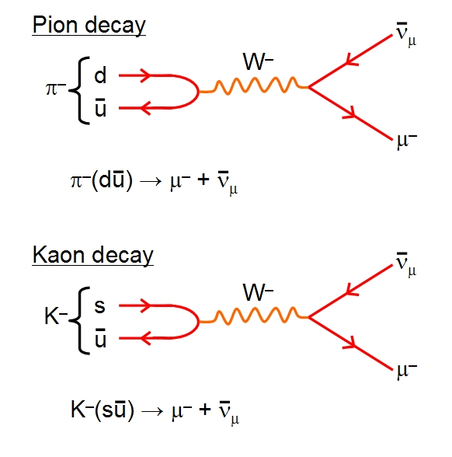
Feynman's Diagrams: Pion and Kaon Decays

Slide 80
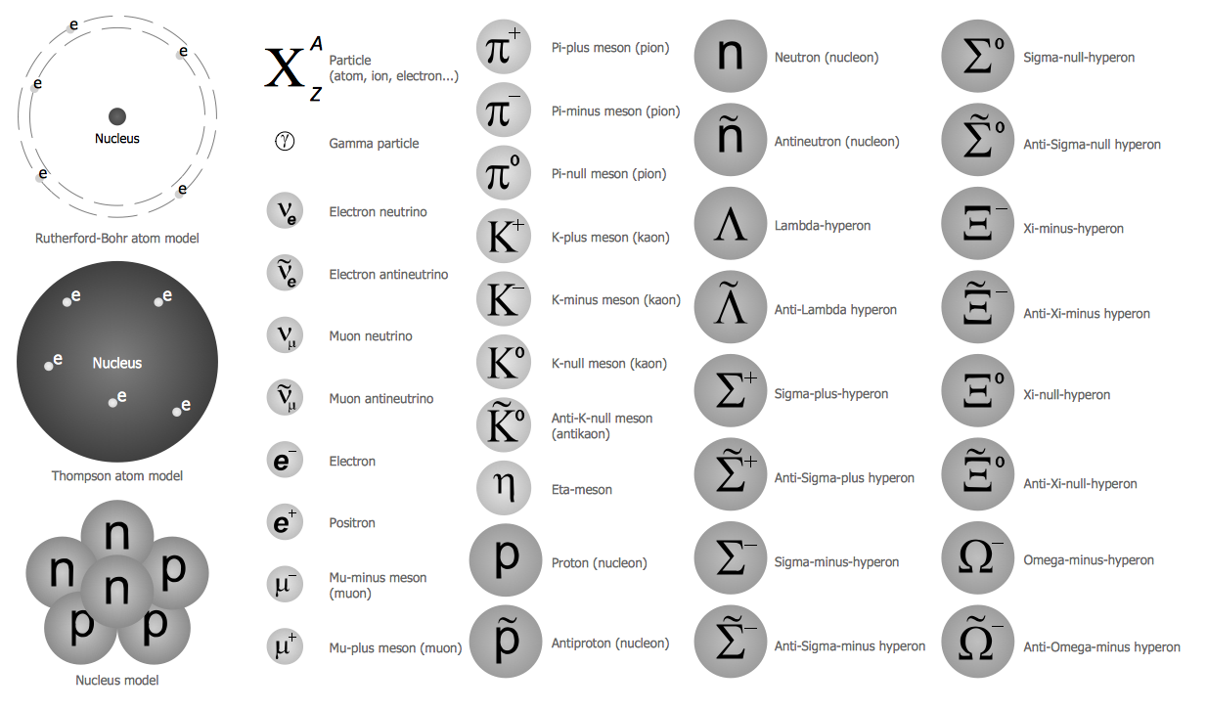
Feynman's Diagrams
The types of particles

Slide 81
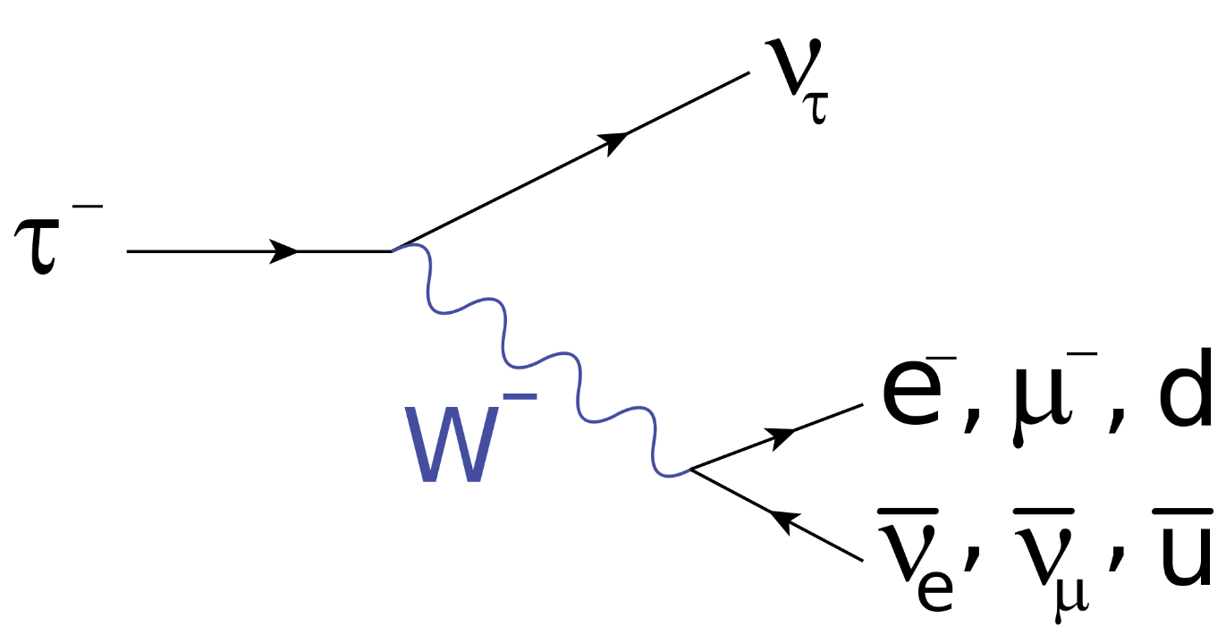
Feynman's Diagrams
Example 9.3a: Explain the diagram below and show it works using the conservation of Baryons, Leptons and Charges.

Slide 82
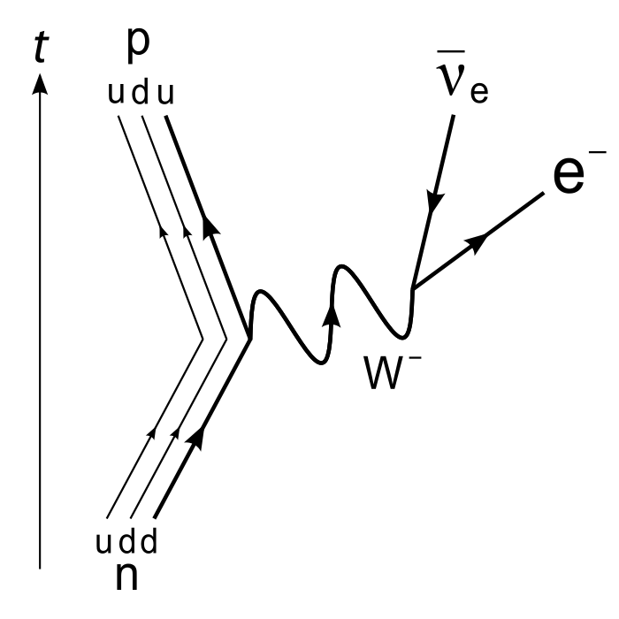
Feynman's Diagrams
Example 9.3b: Explain the diagram below and show it works using the conservation of Baryons, Leptons and Charges.

Slide 83
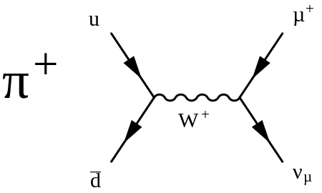
Feynman's Diagrams
Example 9.3c: Explain the diagram below and show it works using the conservation of Baryons, Leptons and Charges.

Slide 84
Feynman's Diagrams
Example 9.3d: Draw a diagram showing two gluons fusing to produce a top quark and an anti-top quark and show it works using the conservation of Baryons, Leptons and Charges.
Example 9.3e: Draw a diagram showing a pion plus decay, where one of the products is a top quark. Show it works using the conservation of Baryons, Leptons and Charges.

Slide 85
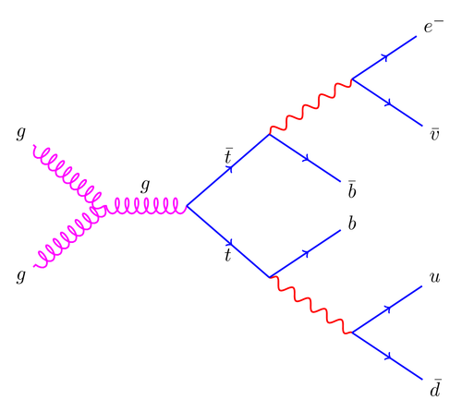
Feynman's Diagrams
Example 9.3f: Explain the diagram below and show it works using the conservation of Baryons, Leptons and Charges.

Slide 86
Energy and Mass
Energy and mass are interchangeable.
E = m c² and E = hc
λ
Example 9.3g:
Calculate the energy released when an electron meets a positron and they are annihilated.
What wavelength (and type) does the photon need to be to produce an electron and a positron.
Example 9.3h:
Determine the kinetic energy of each particle produced when a 3.60 MeV photon produces an electron and a positron.

Slide 87
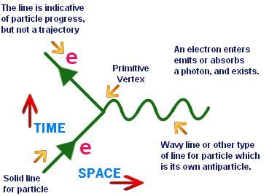
Feynman's Diagrams

Slide 88
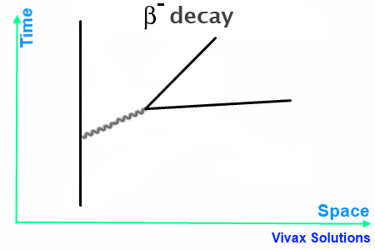
Feynman's Diagrams

Slide 89

Feynman's Diagrams

Slide 90
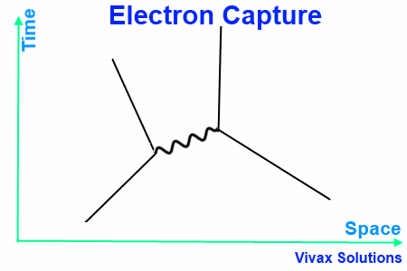
Feynman's Diagrams

Slide 91
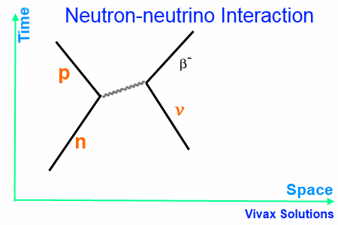
Feynman's Diagrams

Slide 92
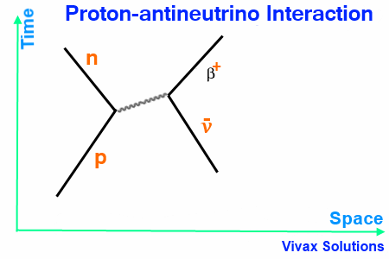
Feynman's Diagrams

Slide 93
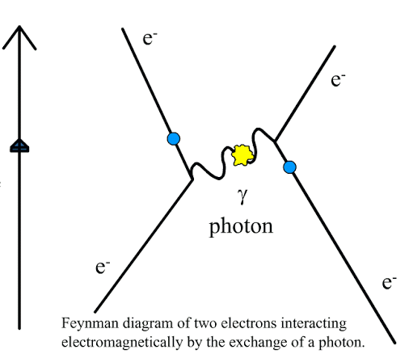
Feynman's Diagrams

Slide 94
Homework, Context & Keywords
Context: How is this content used to better society?
Understanding the make up of principle particles helps us understand the behaviour, integration and interaction of these particles, that leads us to better understand general relativity, and its possible links to special relativity.

Slide 95
Homework, Context & Keywords
Key Words
Feynman
Baryon Number
Lepton Number
Conservation

Slide 96
Homework, Context & Keywords
Homework
Complete all questions from Set 9.3 - due first lesson next week.
Read Chapter 9.4, page 274-279 and answer
Q1 & Q2 Set 9.4
by next lesson.

Slide 97
Page Set up
Set up the first page of every lesson like this and rule a column line for every page after the first page that is used during the lesson.
Focus: State the Chapter Number, Title and the page numbers (3 lines).
Keywords: During the lesson write out your own keywords used during the lesson. (8 lines)
Context: During the lesson write in this section what this topic relates to in the ‘real’ world. How is this content used to better society? (5 lines)

Slide 98
Predicting Reactions using Symmetry
Chapter 9.4 Pages 274 - 279

Slide 99
Symmetry
Three types of symmetry to consider.
Time-reversal symmetry
Charge reversal symmetry
Crossing symmetry

Slide 100
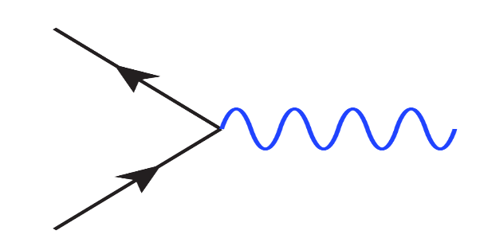
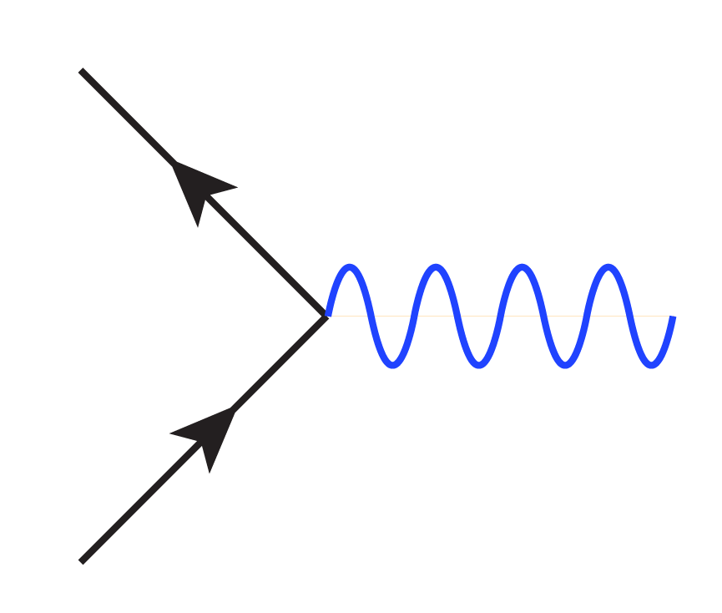
Time-reversal symmetry
What occurs and proves true in one direction, must be the case in the reverse.
So for this simple electron/positron production, the charge, Baryon number and Lepton number is proven conserved.
If we reverse the formula,
creating a electron/positron
Annihilation, then the Charge, Baryon number and Lepton number must still be conserved.
γ
e⁻
e⁺
e⁺
γ
e⁻

Slide 101
Charge reversal symmetry
What occurs and proves true in one formula, must be the case in the other providing all charges are swapped.
So for this simple beta positive decay, the Charge, Baryon number and Lepton number is proven conserved.
If we change the formula, so when particles switch their charges;
Then the Charge, Baryon number and Lepton number must still be conserved.
p⁺ → nº + e⁺ + v_{e}
p⁻ → nº + e⁻ + v_{e}

Slide 102
Crossing symmetry
What occurs and proves true in one formula, must be the case in the other providing all charges are swapped when they switch sides. That is matter becomes antimatter.
So for this simple beta positive decay, the Charge, Baryon number and Lepton number is proven conserved.
If we change the formula, so when particles switch sides;
Then the Charge, Baryon number and Lepton number must still be conserved. Even after the matter particles change to antimatter and vice versa.
p⁺ → nº + e⁺ + v_{e}
nº → p⁺ + e⁻ + v_{e}

Slide 103
Homework, Context & Keywords
Context: How is this content used to better society?
Understanding the make up of principle particles helps us understand the behaviour, integration and interaction of these particles, that leads us to better understand general relativity, and its possible links to special relativity.

Slide 104
Homework, Context & Keywords
Key Words
Time-reversal symmetry
Charge reversal symmetry
Crossing symmetry

Slide 105
Homework, Context & Keywords
Homework
Complete all questions from Set 9.4 - due first lesson next week.
Read Chapter 10.3, page 298-306 and answer
Q1, Q2 & Q3 Set 10.3
by next lesson.

Slide 106
Page Set up
Set up the first page of every lesson like this and rule a column line for every page after the first page that is used during the lesson.
Focus: State the Chapter Number, Title and the page numbers (3 lines).
Keywords: During the lesson write out your own keywords used during the lesson. (8 lines)
Context: During the lesson write in this section what this topic relates to in the ‘real’ world. How is this content used to better society? (5 lines)

Slide 107
Standard Model
Chapter 10.3 Pages 298 - 306

Slide 108
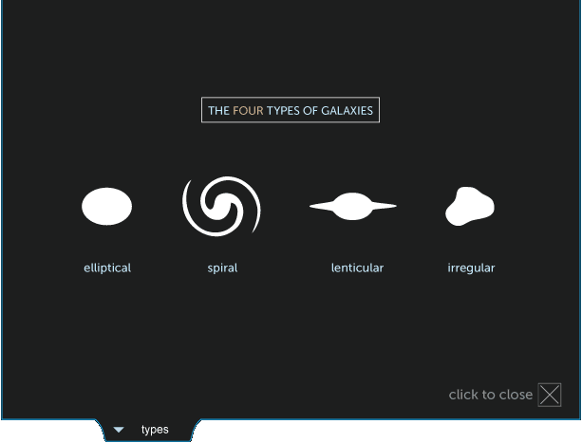
Milky Way
The Milky Way Galaxy is a disc shape with spiral arms.
Popularity amongst the scientific community sees our Milky Way being classed as a spiral galaxy, though some are now saying it is a Barred Spiral.

Slide 109
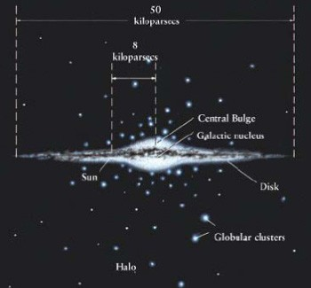
Milky Way
The majority of the solar systems are located in the central bulge, but an estimate of the number of solar systems are hindered by Sagittarius blocking our view of the centre of the galaxy.
The bulge is 15 kpc long and
2 kpc thick
The full length is 50 kpc and
1 kpc thick.
Note: 1 kpc = 3262 light yrs.

Slide 110
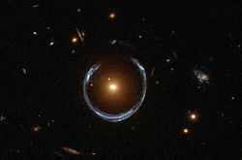
Dark matter
Is a type of matter hypothesised to account for about 27% of the total mass in the universe.
It neither emits nor interacts with light or other electromagnetic radiation at any significant level.
Although dark matter has not been directly observed, its existence and properties are inferred from its gravitational effects; gravitational lensing.

Slide 111
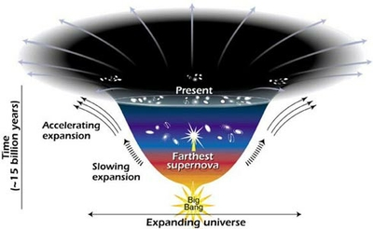
Dark energy
Is a type of energy hypothesised to account for about 68% of the total energy in the universe.
The dark energy is believed to act in opposition to gravity and to occupy the entire universe, accounting for the expansion of the Universe to accelerate.

Slide 112
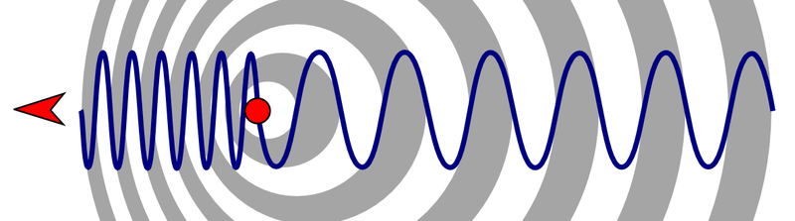
Doppler Effect: Light Waves
Doppler Effect: Light Waves (aka Doppler Shift)
The Doppler effect also occurs in light where the frequency change results in a colour change.

Slide 113
Doppler Effect: Light Waves
The wavelengths for sound match the wavelengths for light.
Red shift is when light emanating from an object that is moving away from the observer has an increased wavelength, hence shifts towards the red end of the spectrum.
Blue shift is where a light source is moving towards an observer, hence the wavelength decreases and the light spectrum shifts to the blue end of the spectrum.

Slide 114
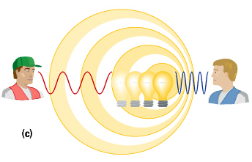
Doppler Effect: Light Waves
Red shift - moving away from the observer, increases the wavelength, hence shifts towards the red end of the spectrum.
Blue shift - moving towards an observer, hence the wavelength decreases and the light spectrum shifts to the blue end
of the spectrum.

Slide 115
Speed of a Galaxy
Speed of a galaxy can be calculated using;
v_{galaxy} = ∆ λ c
λ
where ∆ λ - change in wavelength (m)
λ - normal wavelength (m)
c - speed of light (m s⁻¹)
v_{galaxy} - speed of observed galaxy relative to our own (m s⁻¹).

Slide 116
Speed of a Galaxy
Example 10.3a: A star has an ionised atmosphere of helium. The characteristic wavelength of a certain absorption line in Helium is 471.3 nm. If the spectrum of the star has this line at a wavelength of 500.1 nm, what is the velocity with which the star is moving away.

Slide 117

Speed of a Galaxy
∆ λ = λ_{observed} – λ_{emitted}
= λ_{emitted} $\left(\sqrt{\frac{1+ \frac{v}{c}}{1 − \frac{v}{c}}}\right)$
where ∆ λ - change in wavelength (m) c - speed of light (m s⁻¹)
v - speed of observed galaxy relative to our own (m s⁻¹).

Slide 118
Hubble
Hubble also noticed that more distant galaxies had greater red shift. In fact there was a direct correlation between their distance from ours and their speed. Hence
v_{galaxy} = H_{o} d (Hubble's Law)
where H_{o} – Hubble's constant (70 km s⁻¹ Mpc⁻¹) d – distance from our galaxy (Mpc)
v_{galaxy} – speed of galaxy (km s⁻¹)

Slide 119
Hubble
Give
v_{galaxy} = H_{o} d (Hubble's Law), hence
d = 1 and
v H_{o} where t = d
v
Therefore t = 1
H_{o}
where H_{o} – Hubble's constant (70 km s⁻¹ Mpc⁻¹) d – distance from our galaxy (Mpc)
v_{galaxy} – speed of galaxy (km s⁻¹)

Slide 120
Hubble
Example 10.3b: The age of the Universe is predicted to be the inverse of Hubble's constant. What is the age of the Universe predicted to be?

Slide 121
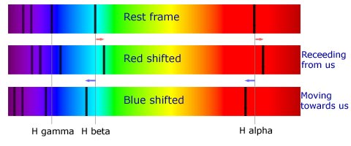
Observing Red Shift using a Spectroscope
The emission line spectrum of a normal ionised element will be as shown in the top image.
If the source is moving away from the observer (i.e. Earth), then the wavelength will increase and the emission lines will shift towards the red end of the spectrum.

Slide 122
Observing Red Shift using a Spectroscope
If the source is moving towards the observer, the lines of the emission spectrograph will shift towards the blue end of the spectrum, hence the term blue shift.

Slide 123
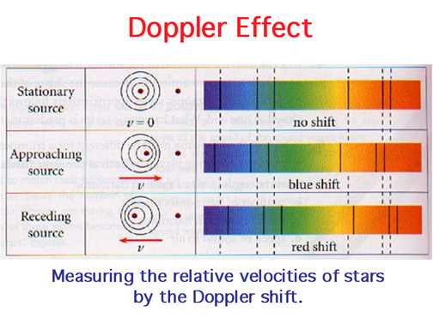
Observing Red Shift using a Spectroscope

Slide 124
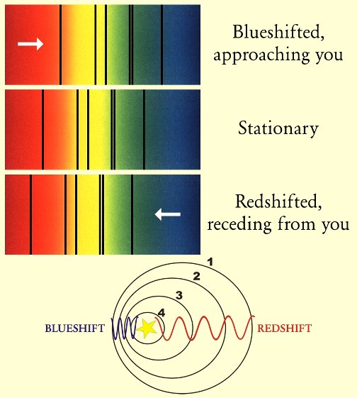
Observing Red Shift using a Spectroscope
Comparing

Slide 125

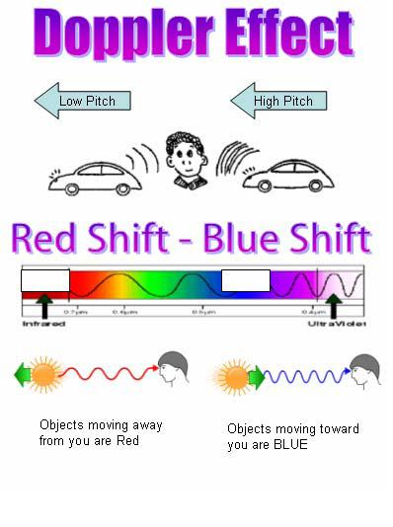
Observing Red Shift using a Spectroscope

Slide 126

Stellar Wobble
Stellar Wobble needs to be considered when determining the change in wavelength (∆ λ) to calculate the galaxy’s speed.
The galaxy is continually observed until its maximum and minimum wavelengths are observed and recorded. The average of these are taken as the actual wavelength.

Slide 127

Observing Red Shift using a Spectroscope
Example 10.3c: Below is the reading of an element; element X, of a distance star at several intervals of time. Of the time stamps shown here, there is the minimum and maximum time intervals, based on the stellar wobble. What is the velocity of this star?
Maximum and minimum wavelengths (x10⁻⁹) recorded
Element X on Earth (x10⁻⁹)

Slide 128
Homework, Context & Keywords
Context: How is this content used to better society?
Understanding the make up of principle particles helps us understand the behaviour, integration and interaction of these particles, that leads us to better understand general relativity, and its possible links to special relativity.

Slide 129
Homework, Context & Keywords
Key Words
Dark Matter
Dark Energy
Red Shifting
Hubble
Wavelength Observed
Wavelength Emitted

Slide 130
Homework, Context & Keywords
Homework
Complete all questions from Set 10.3 - due first lesson next week.
Read Chapter 6.2, page 169-174 and answer
Q1 & Q2 Set 6.2
by next lesson.

